Slide 1
Front End Engineering-II Project
[ Team -2 ]
Jaivardhan Khanna : 2210990429
Jashan Jot Kaur Gill : 2210990436
Jasmine Rathor : 2210990450
Faculty Coordinator:Dr. Baljit Kaur
Chitkara University Institute of Engineering and Technology,
Chitkara University, Punjab

Slide 2
Table of Contents
Introduction
Problem Statement
Technical Details
Key Features
Project Highlights
Conclusion
References/Links used

Slide 3
Introduction
In this project, we will be creating Instagram clone. The project aimed at replicating the core functioning and user experience of Instagram, a popular social media platform for sharing photos and videos.
By using the help of asynchronous fetch methods we have retrieved data from the firebase database and displayed it on our website by integrating it with html and css and rendering all that through ReactJs.

Slide 4
Problem Statement
This project aims to show the use of firebase in order to fetch metadata of provided username from our locally hosted database and display that info on a HTML page rendered page through React.
The primary goal is to create a user-friendly and visually appealing platform that allows user to share moments, connects with friends and explore trending content seamlessly.

Slide 5
Technical Details
The project has used HTML, CSS, and Javascript inside components made in React.
1.) In HTML , we have used :
<div>
<input>
<button>
<a>
<img>
<title>
<br>
<p>
2.) In CSS we have used :
overflow-x
position
z-index
padding
color
font-size
font-weight
background-color
display
width
height
margin

Slide 6
Technical Details
3.) As for React we have used :
Imports:
React library for building user interfaces.
Functions useState and useEffect from React for managing component state and side effects.
makeStyles from Material-UI for creating styles.
Modal, Button, Input components from Material-UI for building UI elements.
Code for connecting to Firebase database and authentication.
Modal Styles and Logic:
getModalStyle function defines the positioning for the modal on the screen.
useStyles hook creates CSS classes for the modal container.
Conditional Rendering:
The UI content changes based on the logged-in state (user).
Logged-in users see a logout button.

Slide 7
Key Features
The project uses a variety of componenets to achieve the following : 1.)User Management:
Registration and Login: Allow users to create accounts and log in securely using email and username.
2.)Content Sharing :
Photo and Video Uploads: Enable users to upload photos and videos from their devices and delete the posts/comments .
Feed: Curate a personalized feed showcasing posts from users .
3.)Interaction Features:
Comments: Enable users comment on posts to interact with content and creators.
Captions: Enable users to caption their posts.

Slide 8
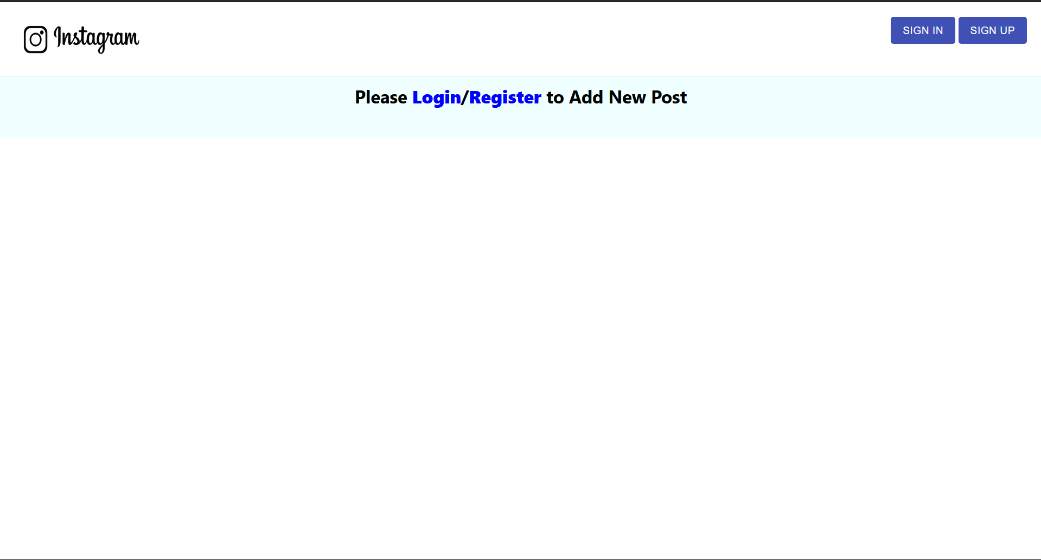
Project Highlights(Login/SignUp Page)
Sign In/Sign Up (button)
Login /Register (ref tag)

Slide 9
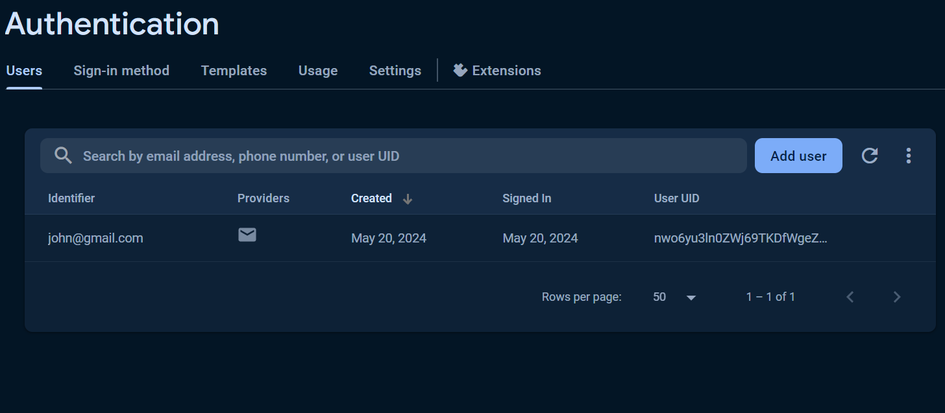
Project Highlights(user credential storage)
Button to add post
User email stored at the time of registration

Slide 10
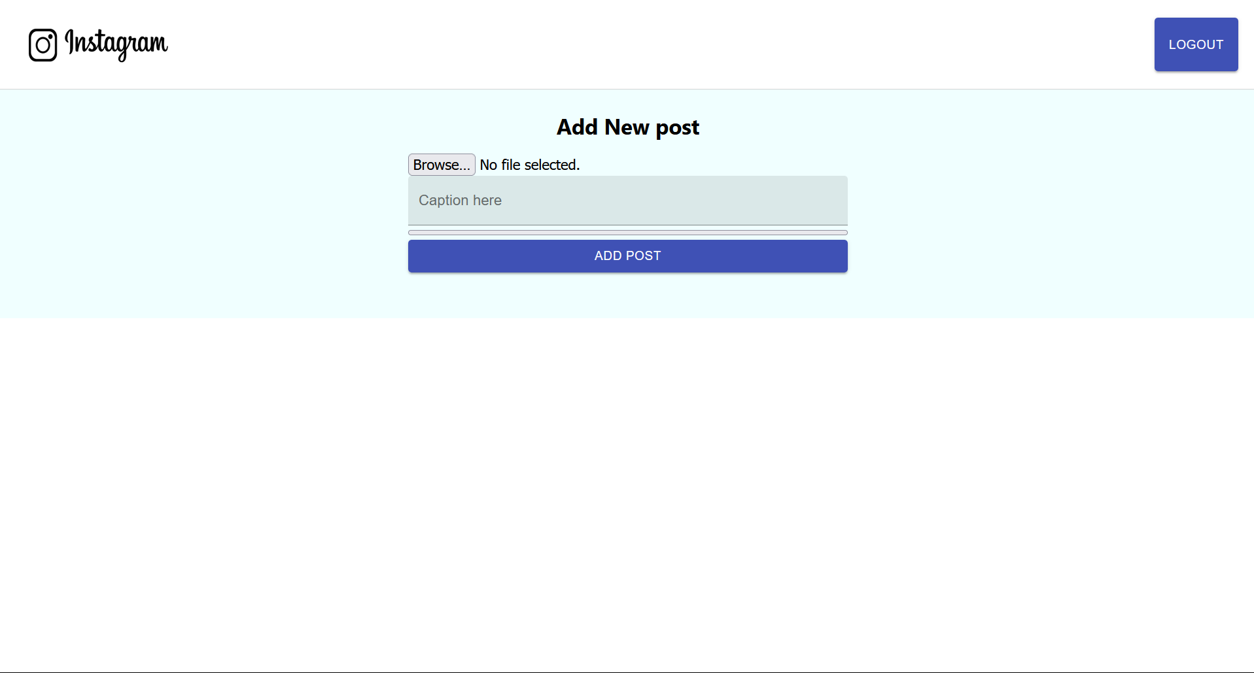
Project Highlights(file upload)
Browse button to locate the file
Button to add post

Slide 11
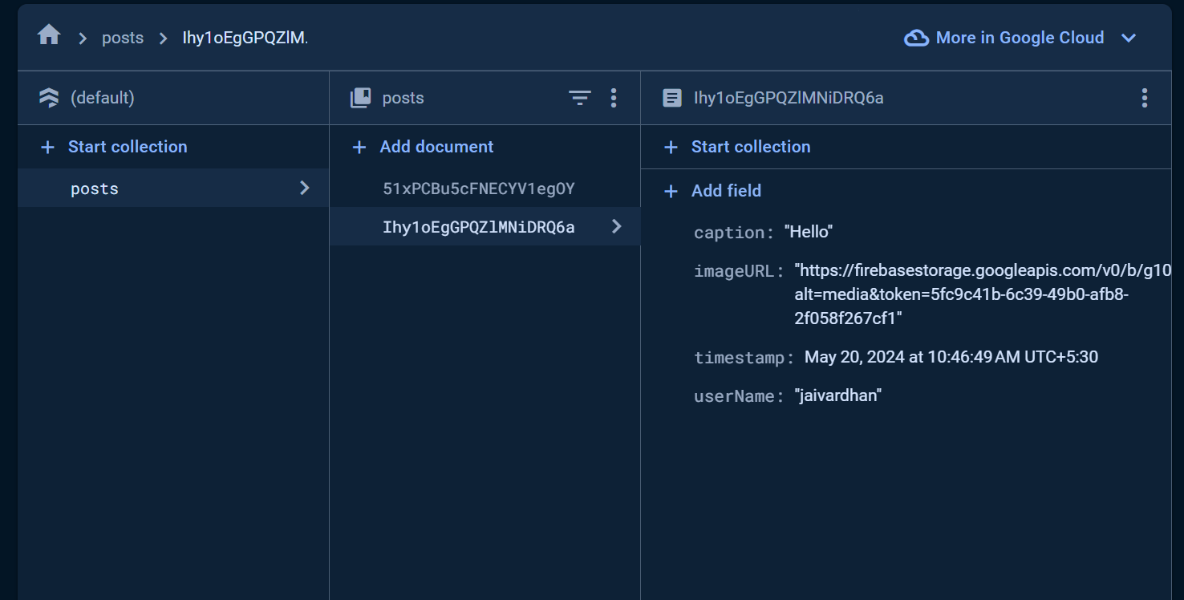
Project Highlights(file upload)
Caption set by the user
Username of the user who posted

Slide 12
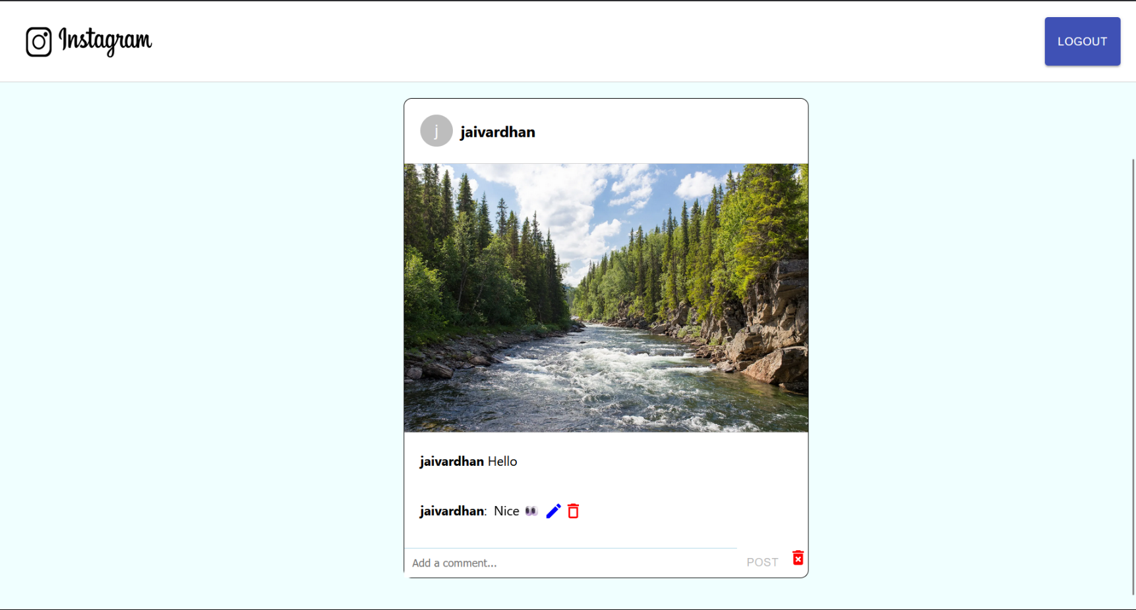
Project Highlights(Final Render)
Caption
Comments

Slide 13
Conclusion
The project was ensuring the security of user data and media upload, particularly in the handling and protection of sensitive information.
The Instagram clone project has been a valuable learning experience like :
1. Uploading photos or videos
2. Navigating through the feed
3. Commenting on posts
4. Providing a seamless user experience

Slide 14
References/Links used
MDN Web Docs - https://developer.mozilla.org/en-US/docs/Web
W3Schools - https://www.w3schools.com/
CSS-Tricks - https://css-tricks.com/
Codecademy - https://www.codecademy.com/
Stack Overflow - https://stackoverflow.com/

